Slide 1
Welcome to Year 3 Meet the Teachers Mr A Abraham(3A) Mrs C Moore(3M)

Slide 2
Information contents
Daily routines
Topics we will cover
Uniform and equipment
Expectations, rewards and sanctions
Homework and reading
Other important information

Slide 3
Daily Routines
PE days are: Wednesday and Friday (3M), Thursday and Friday (3B).
Children to wear their kit to school with school shoes, change into trainers in school.
Year 3 children will have a library slot every Tuesday, books have to be quarantined for 72 hours, so only 1 book per child.
Reading records have been sent home, please record reading including how they found the book.
Colour banded reading books can be changed any day of the week, 1 per child.
Children are strongly encouraged to go to the toilet at break times and lunchtimes and avoid going during lesson times where possible.
Children whose handwriting is consistently sized and joined will be awarded a pen. We aim to give as many children as possible a pen by the end of the year.

Slide 4
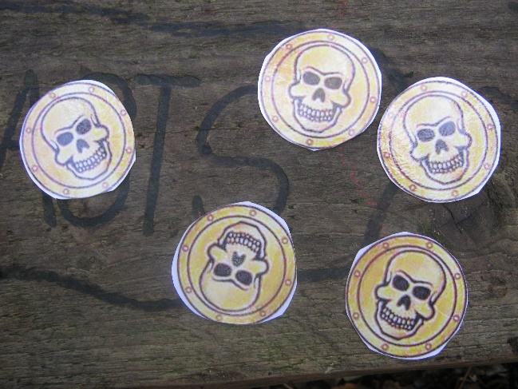
Year 3 Topics
Autumn:
Deadly 60 and Wonderful Winchester
Spring:
Rise of the Robots and Water Worlds
Summer:
Yabba Dabba Doo and
Warrior Britain

Slide 5
Uniform
We ask children to look smart.
No jewellery except watches and/or stud earrings.
Children should wear white t shirts, school sweatshirt or cardigans, which are bottle green and grey skirts, dresses or trousers.
Shoes should be dark coloured. No slip-ons/flip flops please.
Please make sure every item (including shoes!) are named.
Coats- Please ensure your child comes to school with the appropriate outdoor gear for the weather.
Please ensure your child has a named water bottle in school so that they access it throughout the day.

Slide 6
PE Kit
House colour Kings Worthy T-shirt
White shorts
Tracksuit bottoms or leggings for Autumn and Winter
Trainers
Plimsolls or bare feet for indoor PE
Girls need to tie their hair back.
Stud earrings will need to be covered with tape if the child is unable to take them out.
Friendship bracelets/loom bands/watches are not allowed.
Remember to wear jogging bottoms/jumpers when it’s cold.

Slide 7
Equipment
The following items need to be in school every day.
Water bottles
A bag (can be a rucksack or plastic bag)
Reading Diary (Monday and Friday in particular)
Lunchbox (if appropriate)
All equipment to be brought in one bag please to avoid overcrowding the cloakroom.

Slide 8
Expectations
We have reward systems to encourage good behaviour and focussed learning.
Superstars and Best Learner
House points
Awarding privileges and responsibilities
Celebration Assembly in Key Stages
The Outstanding Certificate
Sanctions will be used if necessary in line with our behaviour policy (on website).

Slide 9
Home Learning
Reading (4 times a week) – Diaries will be checked weekly on a Friday.
Maths (Every two weeks): Children will be set written maths work or MyMaths tasks. Children are expected to know all of their tables by the end of year 4 and therefore the sooner they start to learn them, the better.
English (Every two weeks): Children will be set a mixture of handwriting challenges and spelling investigations fortnightly.
All homework is set on a Friday, to be handed in the following Wednesday, to be completed online or in homework books as appropriate.

Slide 10
Home Learning
Communication
Website – Year 3 page
Termly Newsletter
Weekly whole school Newsletters
Individual letters for visits
Parent mails

Slide 11
Other Important Information
Absence: Hampshire guidance.
Letter of absence needed for each session or late arrival. See updated guidance for COVID 19 sent home by Mr Dodson, August 2020.
Nuts: Due to nut allergies in school please do not send any form of nuts in your child’s lunchbox.
Healthy Schools: In support of our commitment to being a healthy school, please do not send in sweets or cakes for birthdays.
Snacks: Children in KS2 are not provided with a snack at playtime, so they may bring their own. Please ensure that this is a healthy item such as: fruit or veg

Slide 12
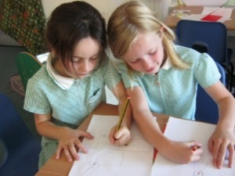
Other important Information
Headlice: If your child has an itchy head, please let us know so we can issue the standard letter!
Keeping hair tied back helps!
Please follow the one-way systems around the school premises, see newsletters for updates.
Due to COVID 19 restrictions, we will not be asking for in-school volunteers for reading until January 2020.

Slide 13
Questions or concerns
Come in and see us if you have any concerns or write a note.
If you feel it will take more than a minute or two, please make an appointment after school so we can discuss it properly.

