Slide 1
Meet the Teacher
Year 5
2023-24

Slide 2
Teaching...
Year 5 team
Teachers | 5S – Mrs Smallwood 5VT – Miss Van Tuyl (Mrs Williamson after Christmas)
LSAs Throughout Year 5 | Mrs Harkay Mrs Griffin Mrs Rolfe
PPA Cover - Wednesday | Mr Potter (PE) Mdm. Miller (French)
5VT Thursday afternoons | Mrs Anning

Slide 3
Learning...
We will be covering the following topics throughout Year 5:
Vikings
Space and Sweden
Sustainability in Kings Worthy
Ancient Civilisations – Shang Dynasty
Ancient Maya
Brazil
There will be our usual Winchester Science Centre and Planetarium trip in Autumn 2 – we are currently in the process of planning a date for this.

Slide 4
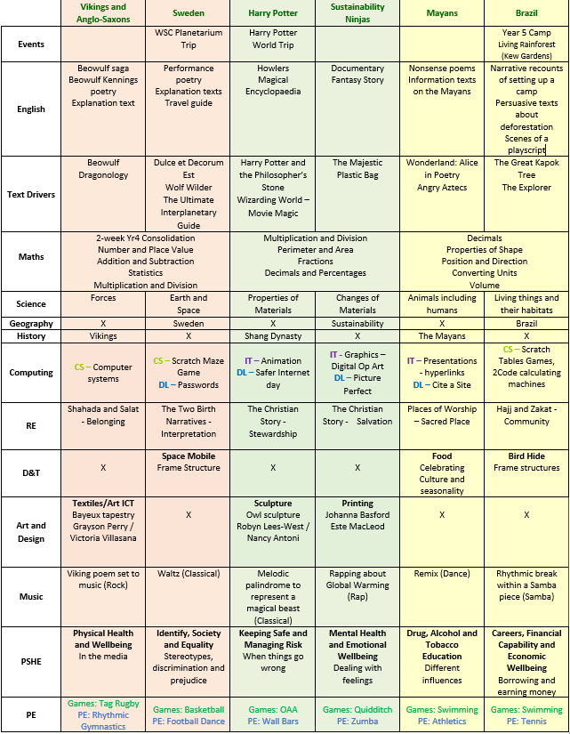
Learning...
Our curriculum map will also be uploaded on our website pages so you are able to see what we will be covering in different units throughout the year.

Slide 5
Other opportunities...
We are very much looking forward to organising some exciting learning opportunities outside of school this year!
Autumn – Winchester Science Centre and Planetarium
Spring – Harry Potter Studios
Virtual Reality session about Climate Change
Summer – Swimming Lessons
Year 5 Camp!
Kings Worthy Production
More details about any trips or events will be sent out via email closer to the time.

Slide 6
Parent contributions...
We are aware that our cost of living is rising, and some may wish to plan in some of our trips and events with estimated costings for this year:
Winchester Science Centre (Oct/Nov) - £15.00
Virtual Reality (Jan/Feb) - £4.00
Harry Potter Studios (March) - £30.00
Year 5 Camp (June) – £14.00
Swimming (May) - £33.00
Please come and speak to us if you have any questions about these costings. They are estimations, and could change.

Slide 7
Homework...
Maths/English homework – Google Classroom (paper copies given)
Maths and English homework is set on alternate weeks.
Maths homework will focus on consolidation or revision of a subject we have covered in Year 4 or 5.
English homework will be consolidating an area studied in class (spelling or grammar), including spelling shed.
Ed Shed logins allow access to Maths Shed and Spelling Shed.
Homework is set on a Friday and due in the following Wednesday.
Reading
Recorded in the reading diary at least 4 times per week. When 4 entries are written in, children will have an ‘S’ recorded and will indicate 3 house points.
Please ensure to initial children’s entries.
These will be collected by class teachers on a Friday.
Reading diaries should be brought into school every day.
Library days will be Friday and Tuesday.

Slide 8
Additional Home Activities...
Login information can be found in the back of children’s reading diaries for the following websites:
Purple Mash
Ed Shed:
Spelling Shed
Maths Shed
Times Table Rockstars
There are a range of games and challenges that children can explore at home in addition to set homework.

Slide 9
Rewards...
House Points – given by any member of staff for effort or achievement. Codes at the bottom of their work mean house points have been awarded.
Behaviour board - Every child starts off daily on the ‘You’re great’. For good behaviour, children can have their name moved to ‘Superstar’ or where poor behaviour is shown down to ‘Stop and Think’. Children can have their names moved up and down accordingly throughout the day. Each ‘Superstar’ receives a sticker at the end of the day.
Best Learner – One child who has stood out for excellent learning behaviours throughout the day will be awarded ‘best learner’. A special sticker is awarded and 3 house points..
Celebration Assembly – showing an outstanding piece of work, kindness or effort that exemplifies ‘Be the Best You Can Be’. This is a virtual assembly which will be uploaded onto the individual child’s Google Classroom on a Friday.
Class Gem Reward Chart – children work towards a class goal e.g. co-operation and supporting each other. When the chart is full the class receive a reward of their choosing.
Outstanding Certificates – When children have completed a piece of work that is to an ‘outstanding level’ for them, we will award an outstanding certificate. It will be signposted in their books and Mr Dodson will come into the classroom and present the certificates to the children on a Friday afternoon.

Slide 10
Reminders...
PE
PE days – Monday and Wednesday
Children will need to come into school dressed in their PE kit on these days.
Trainers need to be kept in their locker so that they can change into these when necessary.
Water bottles
Please ensure your child has a named water bottle in school every day.
Uniform
Guidelines on our website, please send a note or speak to us on the door if they haven’t got the correct uniform. Please mark all belongings clearly.

Slide 11
Reminders...
Collection Arrangements
Please ensure you have spoken to the class teacher or emailed the admin office if your child is walking home from the classroom, or meeting adults at a different place from the Year 5 classrooms so we have an up-to-date record.
Medical
We have children in school with severe allergies – please don’t include food with nuts for snacks or packed lunches, or send food items on birthdays.
A healthy snack can be brought for morning break time.

Slide 12
School Website...
We will regularly update our Year 5 page on the website with photos of our adventures in and outside of school. This will also include information about the dates for our RE and PSHE days.

Slide 13
Any questions?

