Slide 1
Welcome to Year 3 Meet the teachers Mrs R Holloway (3H) Miss C Singleton (3S)

Slide 2
Information contents
Daily routines
Topics we will cover
Uniform and equipment
Expectations, rewards and sanctions
Homework and reading
Other important information

Slide 3
Daily Routines
PE days are: Monday and Thursday
Children will have a library slot every Friday.
We’ve sent home reading diaries, please record reading including how they found the book. Children on gold or above can record their own reading in their diary (date, title and a note on what they thought).
Children are strongly encouraged to go to the toilet at break times and lunchtimes to avoid going during lesson times where possible.
Children whose handwriting is consistently sized and joined will be awarded a pen. We aim to give as many children as possible a pen by the end of the year.

Slide 4
Year 3 Topics
Autumn:
Deadly 60 and Wonderful Winchester
Spring:
Rise of the Robots and Water Worlds
Summer:
Yabba Dabba Do and
Welcome to the Jungle!

Slide 5
Uniform
We ask children to look smart.
No jewellery except watches and/or stud earrings.
Children should wear white t shirts, school sweatshirts, cardigans or fleeces which are bottle green and grey skirts, dresses or trousers.
Shoes should be dark coloured. No slip-ons/flip flops please.
Please make sure every item (including shoes!) are named.
Coats- Please ensure your child comes to school with the appropriate outdoor gear for the weather.
Please ensure your child has a named water bottle in school so that they access it throughout the day.

Slide 6
PE Kit
House colour Kings Worthy T-shirt
White shorts
Tracksuit bottoms or leggings for Autumn and Winter
Trainers
Plimsolls or bare feet for indoor PE
Girls need to tie their hair back.
Stud earrings will need to be covered with tape if the child is unable to take them out.
Friendship bracelets/loom bands/watches are not allowed.
Remember to wear jogging bottoms/jumpers when it’s cold.

Slide 7
Equipment
The following items need to be in school every day and all items need to be named please.
Water bottles
Book bags
Reading Diary (Reading diaries will be checked once a week and house points for reading given out)
Please can Reading diaries be brought in everyday
Trainers for PE

Slide 8
Expectations
We follow the school behaviour system.
Rewards for positive behaviour:
Superstars, Best Learner
House points
Awarding privileges and responsibilities
Celebration Assembly
The Outstanding Certificate
Sanctions will be used if necessary in line with our behaviour policy (on website).

Slide 9
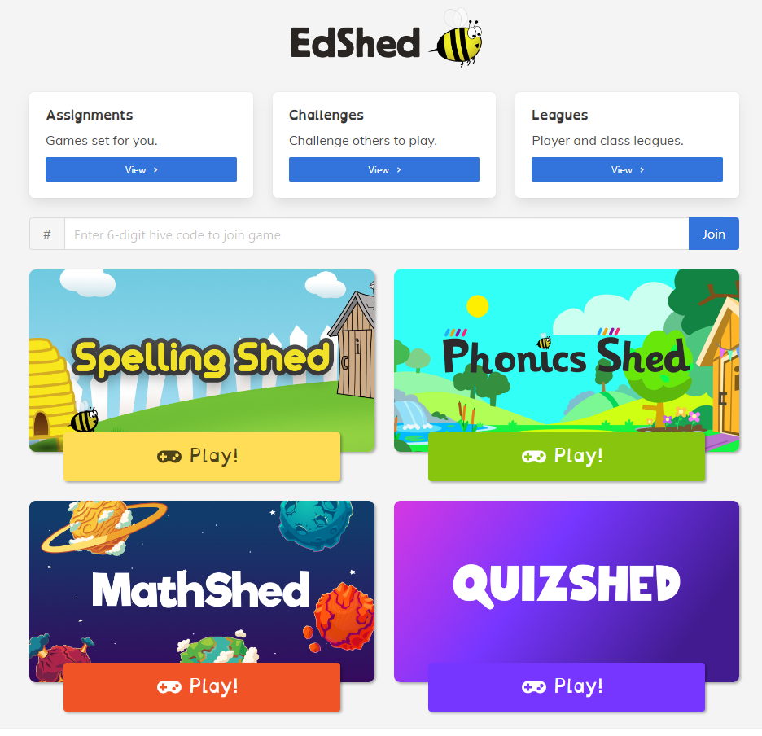
Home Learning
All homework will be communicated via Google Classroom, please let us know if you need your child’s login sent home.
Reading (4 times a week) – Diaries will be checked weekly, children who read 4 times in a week get 3 house points.
Maths (Every two weeks): Children will be set maths tasks every fortnight. Children are expected to know all of their tables by the end of year 4 and therefore the sooner they start to learn them, the better.
English (Every two weeks) Children will be set spelling homework every fortnight.

Slide 10
Home Learning
Communication
Website – Year 3 page
Termly Newsletter
Weekly whole school Newsletters
Individual letters for visits
Parent mails
On the door
Email via the office

Slide 11
Other Important Information
Absence: Hampshire guidance.
Please ring/email or write to the school to inform us of any absence.
Nuts: Due to nut allergies in school please do not send any form of nuts in your child’s lunchbox.
Healthy Schools: In support of our commitment to being a healthy school, please do not send in sweets or cakes for birthdays.
Snacks: Children in KS2 are not provided with a snack at playtime, so they may bring their own. Please ensure that this is a healthy item such as: fruit or veg

Slide 12
Other important Information
Headlice: If your child has an itchy head, please let us know so we can issue the standard letter!
Keeping hair tied back helps!
Plea for missing library books

Slide 13
Questions or concerns
Come in and see us if you have any concerns or write a note.
If you feel it will take more than a minute or two, please make an appointment after school so we can discuss it properly.

